Slide 1
MSAR Findings
By: George Phung

Slide 2
Various Findings/Edits
In the Additional Info section, a quarter refers to a 10-week “session” compared the semester where a session typically lasts for 15 weeks
BCHM under Class stands for Behavioral and Social Sciences
Some medical schools uses AMCAS to determine which courses are eligible are not
Some medical schools accept online course credit, given if it was during the COVID-19 pandemic.
Most schools require 1 academic year of physics, English, chemistry, and biology.
There are also medical schools in Canada and Puerto Rico listed
Did more specific categorization based on the class column

Slide 3
Very basic statistics
Schools w/ online BCHM:
Schools that allow online BCHM: 76 (59.4%)
Schools that do not allow online BCHM: 24 (18.4%)
Case-by-Case: 28 (21.9%)
Schools w/ CC BCHM:
Schools that allow BCHM from CC: 101 (78.9%)
Schools that do not allow BCHM from CC: 16 (12.5%)
Case-by-Case: 11 (8.6%)

Slide 4
Other classes
Schools w/ online BESS:
Schools that allow online BESS: 10 (52.6%)
Schools that do not allow online BESS: 2 (10.5%)
Case-by-Case: 7 (36.8%)
Schools w/ online BIOL:
Schools that allow online BIOL: 200 (59.0%)
Schools that do not allow online BIOL: 47 (13.9%)
Case-by-Case: 92 (27.1%)
A Kruskal-Wallis test found no significant relationship between course type and medical-school acceptance ratios (p = 0.41).

Slide 5
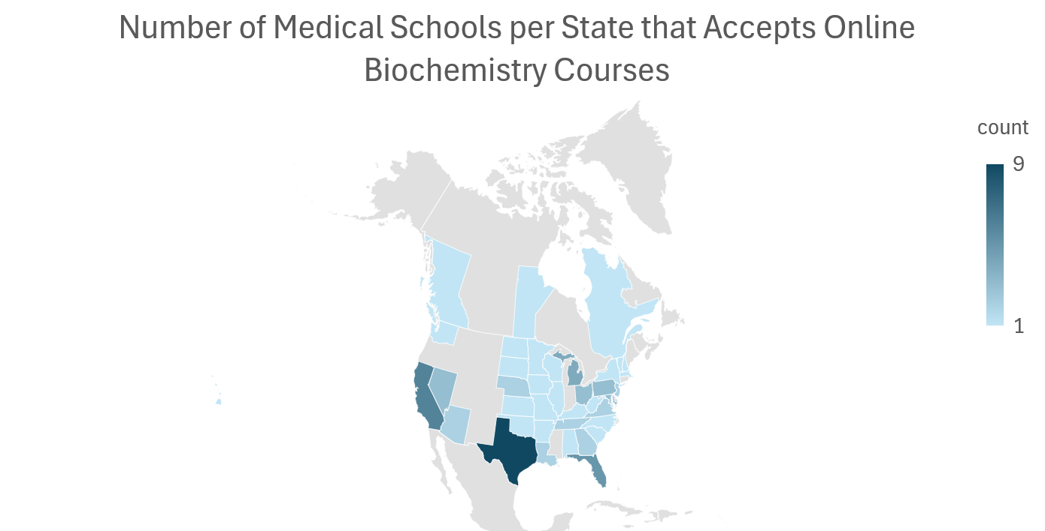

Slide 6
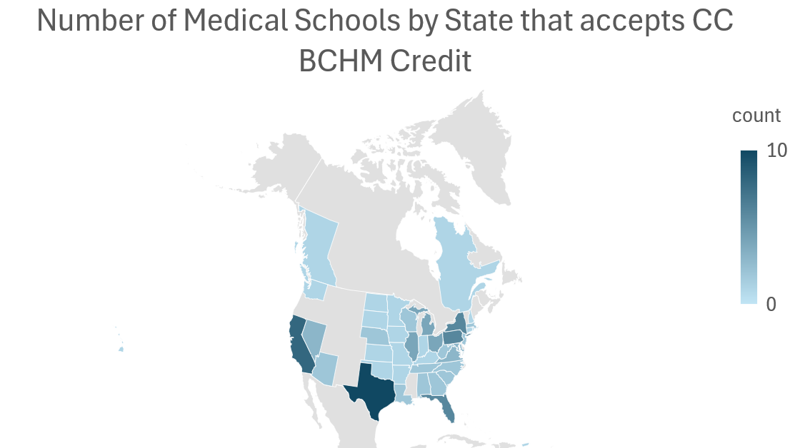

Slide 7
